Slide 1
Monte Carlo tree search with spectral expansion for planning with dynamical systems
Benjamin Rivière, John Lathrop, Soon-Jo Chung
Presented by 周桢瑜

Slide 2


Benjamin Riviere
Aerospace PhD, California Institute of Technology
Soon-Jo Chung
Bren Professor of Control and Dynamical Systems at Caltech; JPL Senior Research Scientist

Slide 3
Background
The goal of robotics research is to develop robots with reliable autonomous decision-making for applications like exploration, autonomous vehicles, and urban air mobility. However, solving decision problems in high-dimensional spaces faces the "curse of dimensionality." Autonomous robots often use problem-specific approaches, such as sampling-based motion planning, convex optimization for trajectory planning, and value iteration for high-level decisions, to gain computational advantages. While effective, these solutions are limited by their inability to easily adapt to new problems, increasing the burden on multi-task autonomy design.

Slide 4
Background
This paper introduces Spectral Expansion Tree Search (SETS), a real-time planning algorithm for robots that overcomes the limitations of Monte Carlo Tree Search (MCTS) by using spectral properties of locally linearized systems to create low-complexity, discrete representations of continuous environments. This approach allows for efficient planning without needing specialized algorithms for each problem instance.

Slide 5
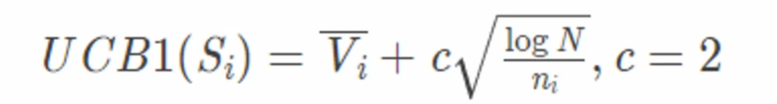

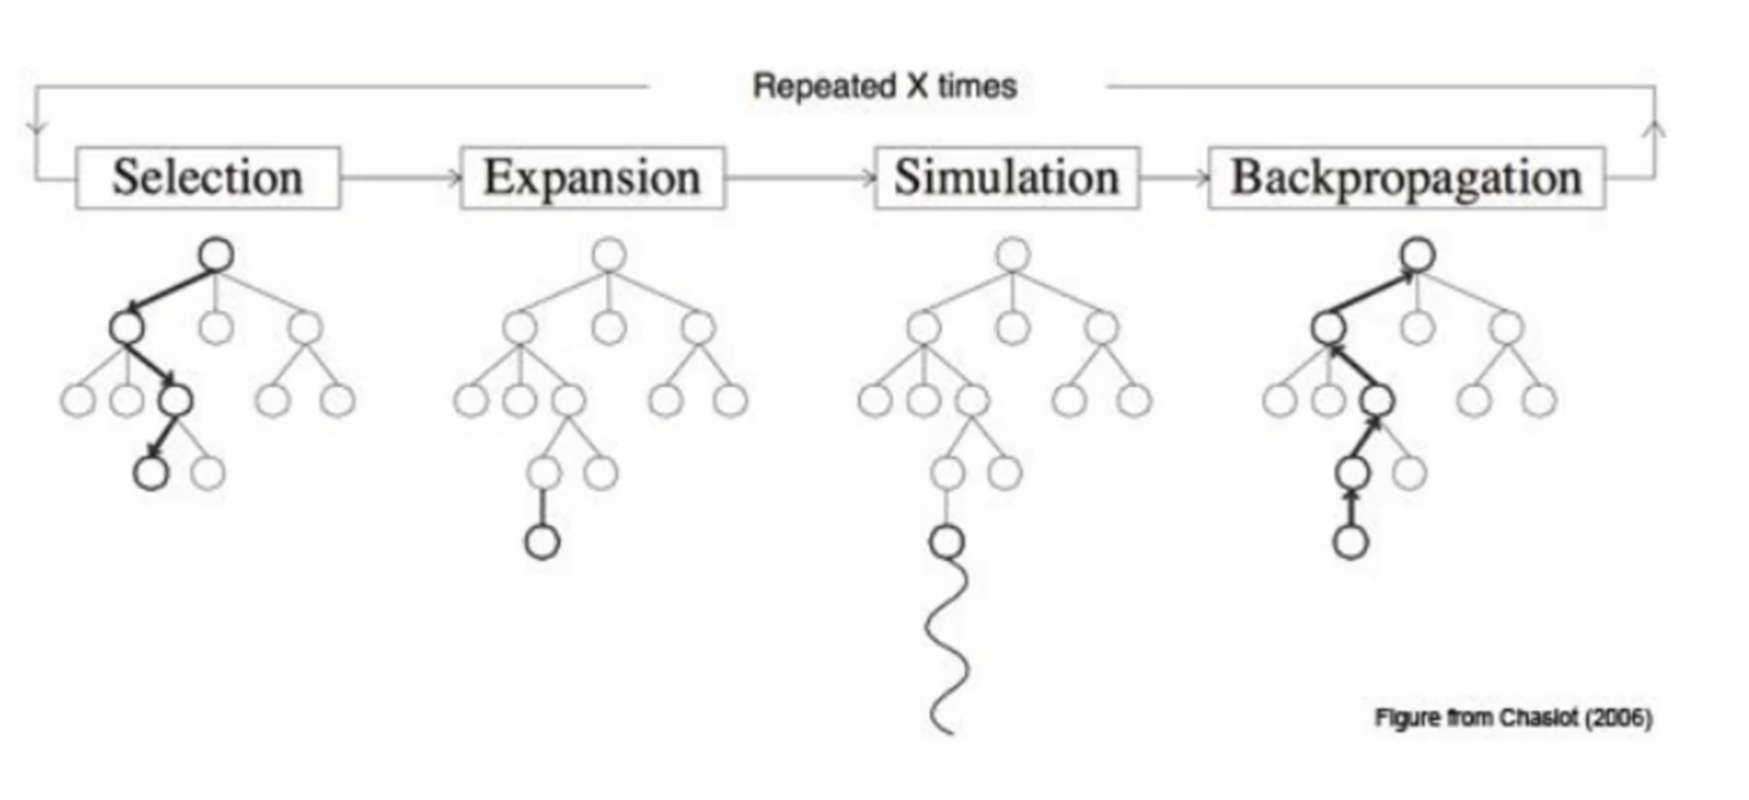
Monte Carlo Tree Search (MCTS)
MCTS is a tree-based planning algorithm used to find optimal solutions in complex and high-dimensional search spaces. Its core idea is to efficiently explore and exploit the search space within a limited computational budget by combining simulation (Monte Carlo Sampling) and tree structure (Tree Search).

Slide 6
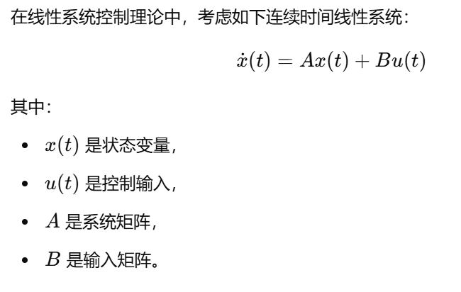
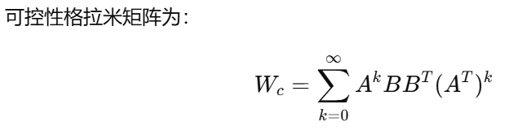

Controllability Gramian
可控格拉米矩阵也可以表示系统在时间内可以达到的状态范围。我们需要对可控性格拉米矩阵进行谱分解，即计算特征值和特征向量（通常需要先进行归一化）。
通过特征向量可以计算出一个椭球状的包络面，这个包络面内的范围就是“可达的”。
我们将每个特征向量称为“主轴”方向，某个特征向量对应的特征值越大，那么系统在这个方向上可控性越强，反之亦然。
H

Slide 7
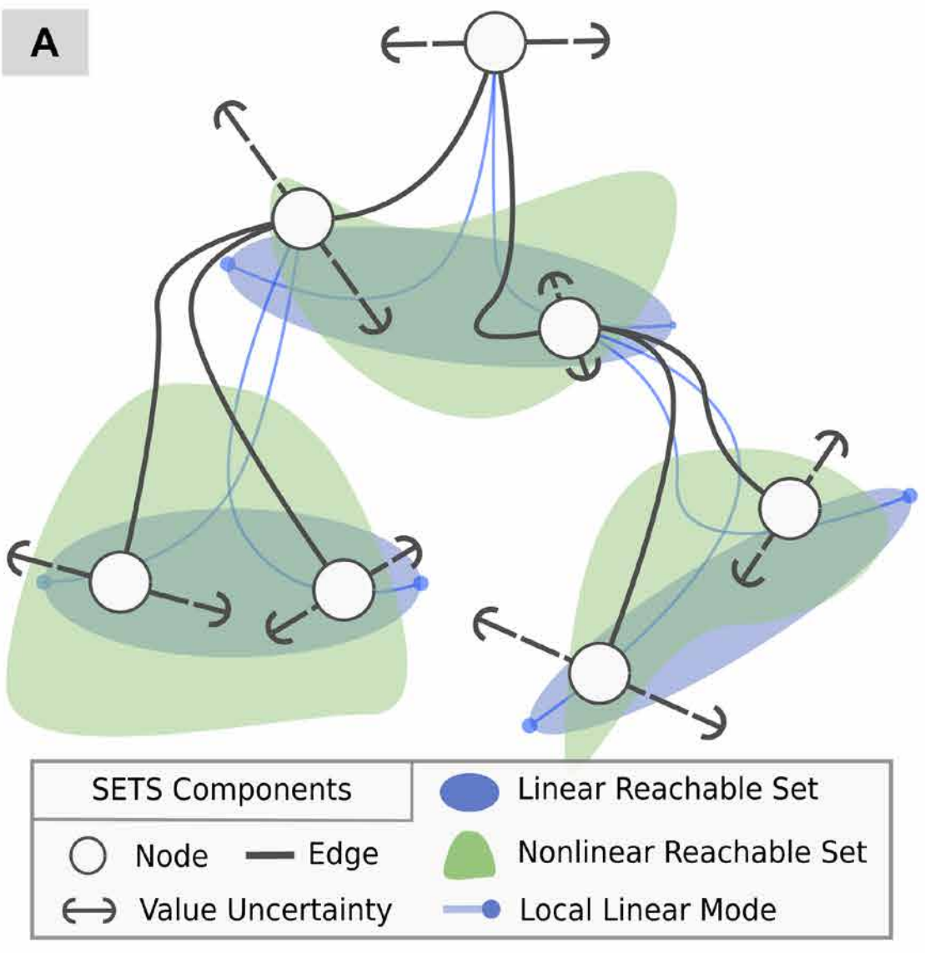
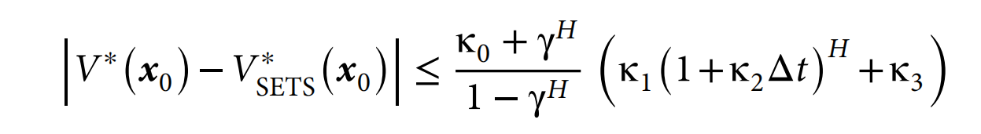
Spectral Expansion Tree Search (SETS)
SETS is an innovative real-time planning algorithm designed specifically to address planning problems in high-dimensional continuous dynamic systems. It achieves discretization of continuous problems through local linearization and spectral expansion techniques, ensuring the convergence to a global optimal solution.

Slide 8
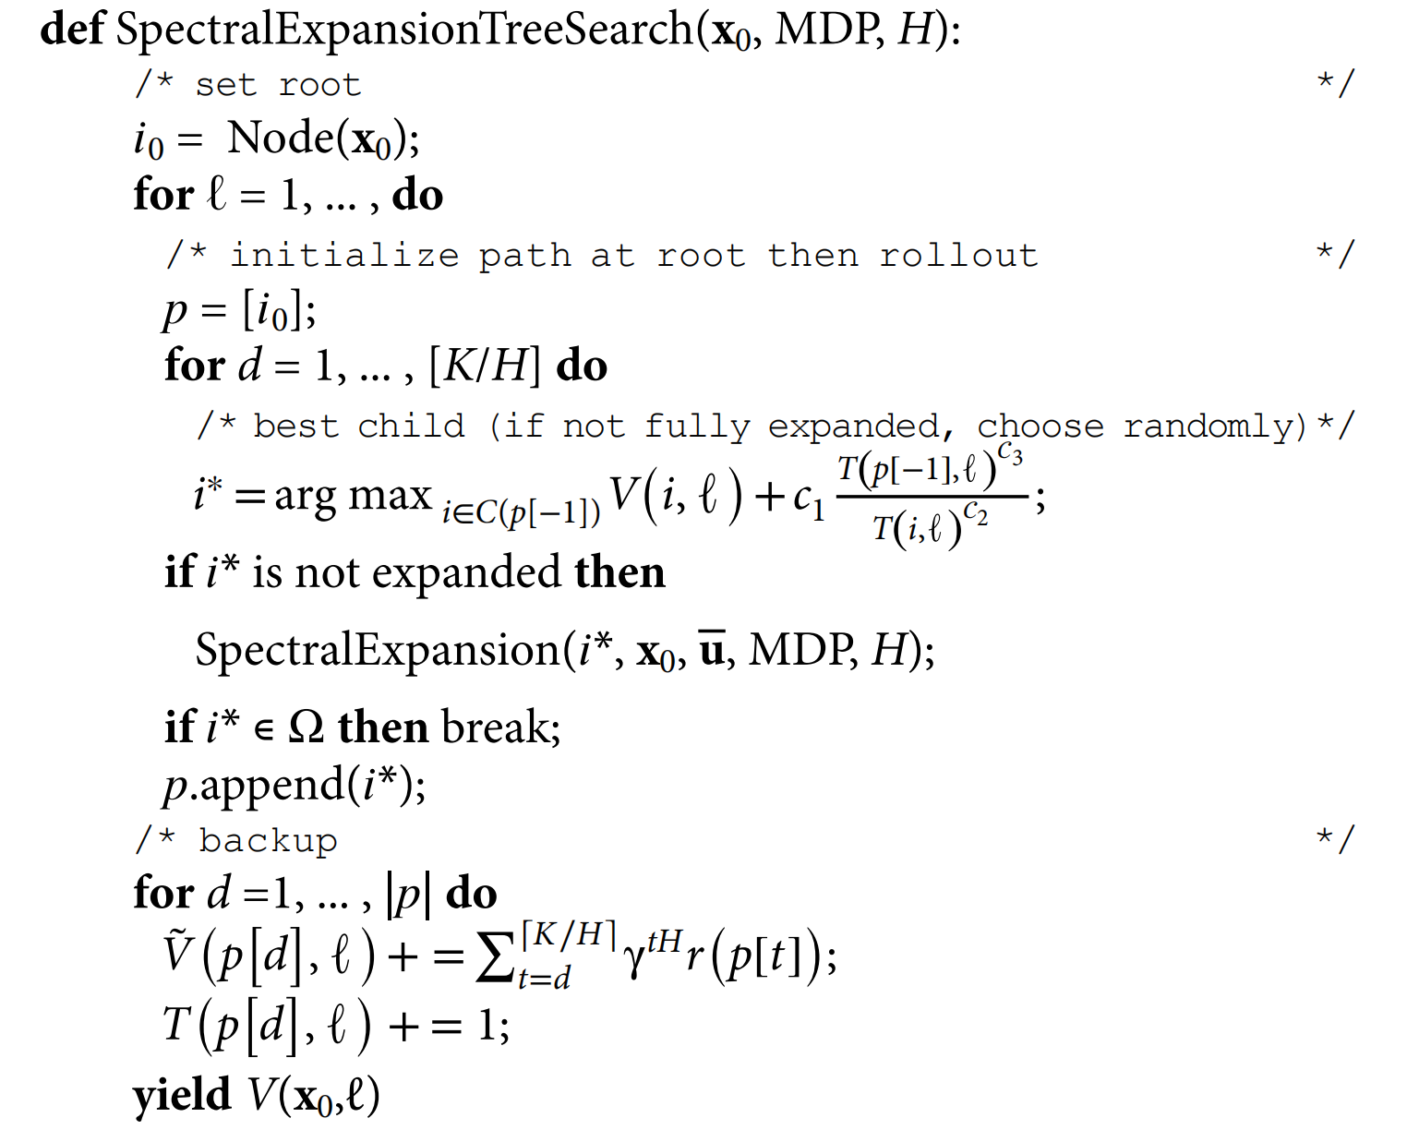
Algorithm

Slide 9
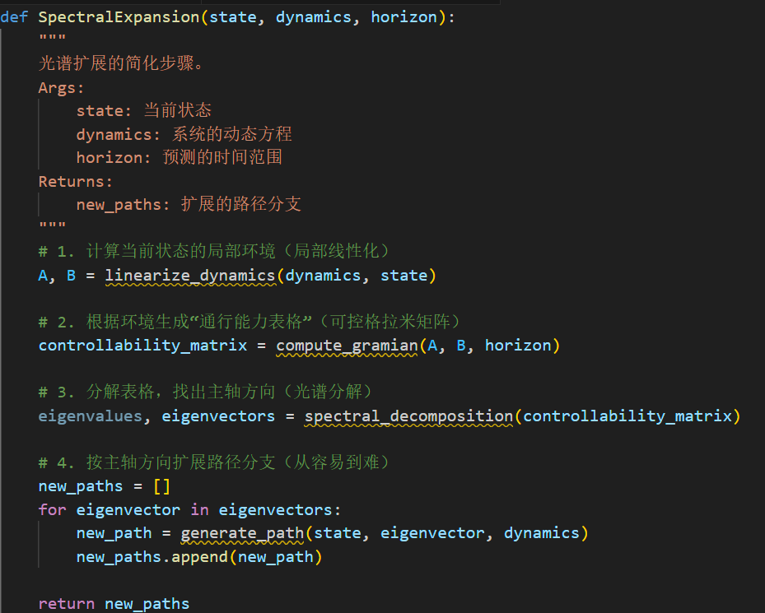
Algorithm

Slide 10
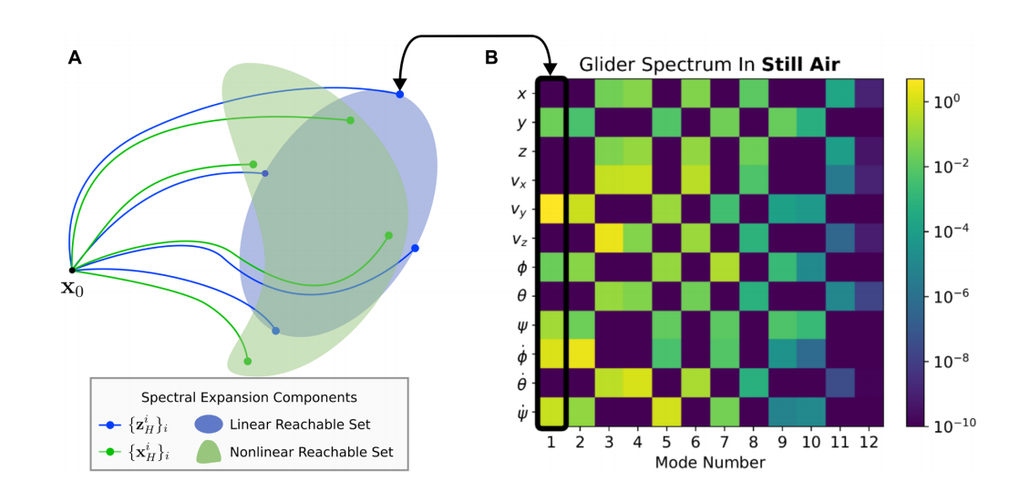
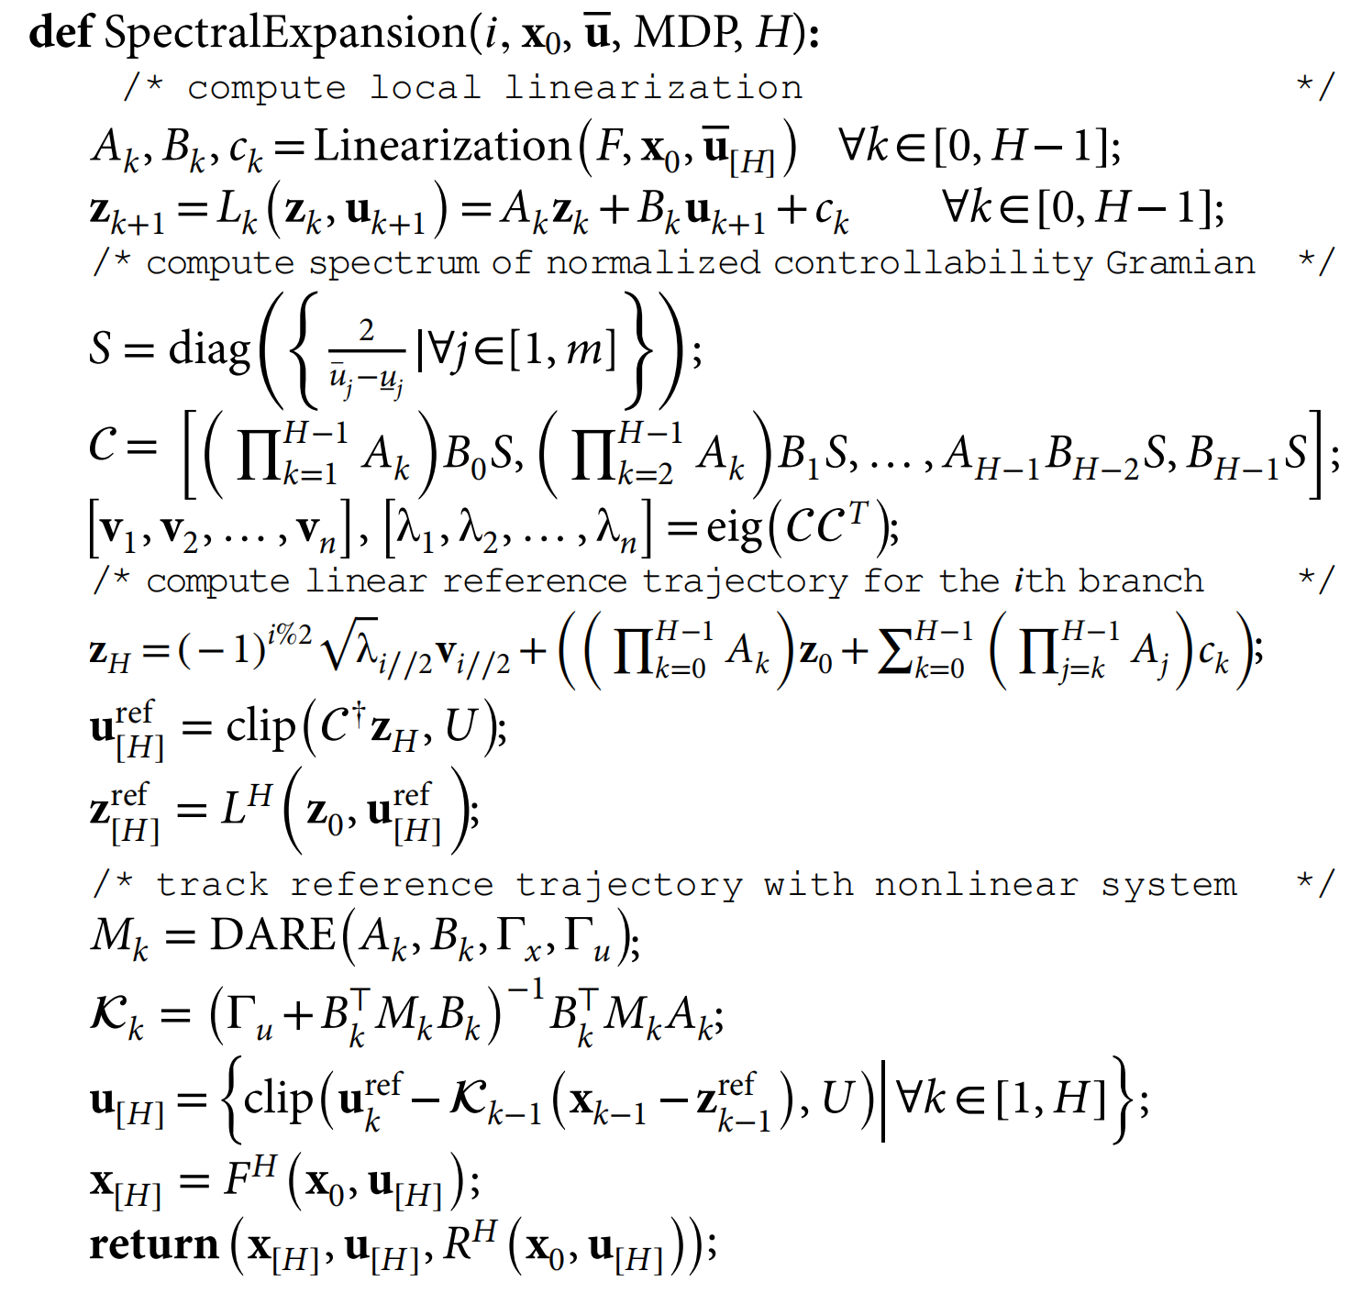
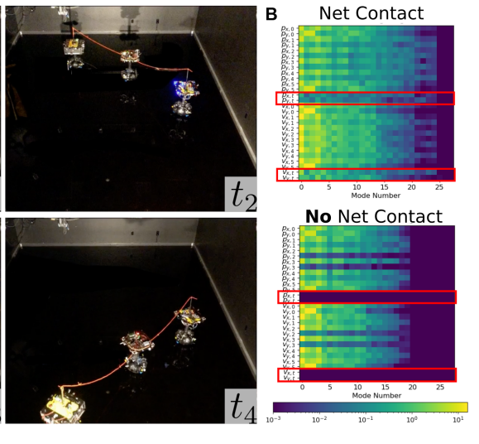
Algorithm

Slide 11
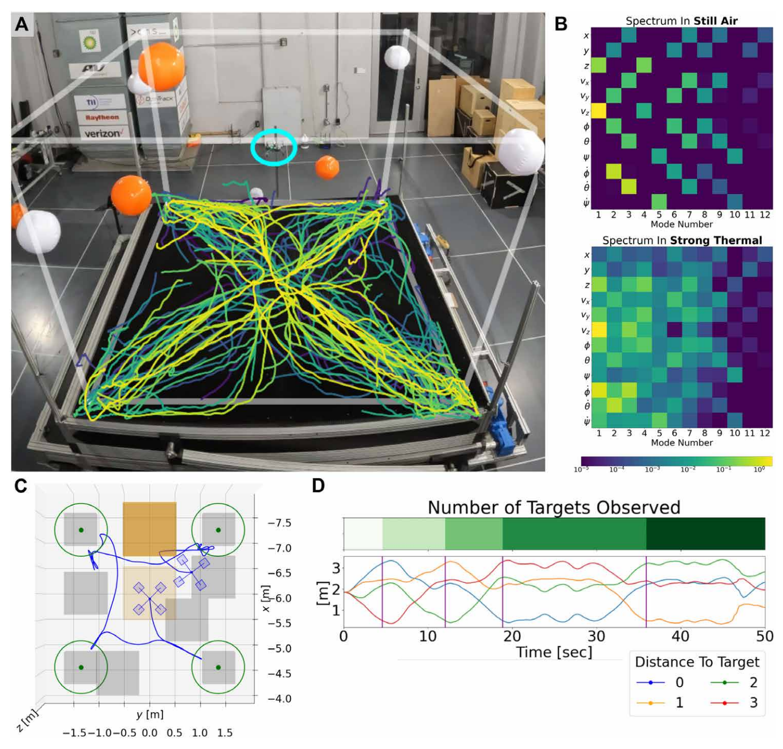
Experiment
The task involves a quadrotor drone navigating a 3-meter cubic space with the objective of visiting multiple target points in a 3D wind field. The drone must complete the mission in the shortest possible time while avoiding dynamic obstacles, such as wind-suspended balls, and hazardous regions created by irregular wind flows from a fan array.
The targets and danger zones are distributed throughout the environment, requiring efficient path planning. Its 12-dimensional state space includes position, velocity, attitude angles, and angular velocity, enabling precise control in complex and dynamic conditions.

Slide 12
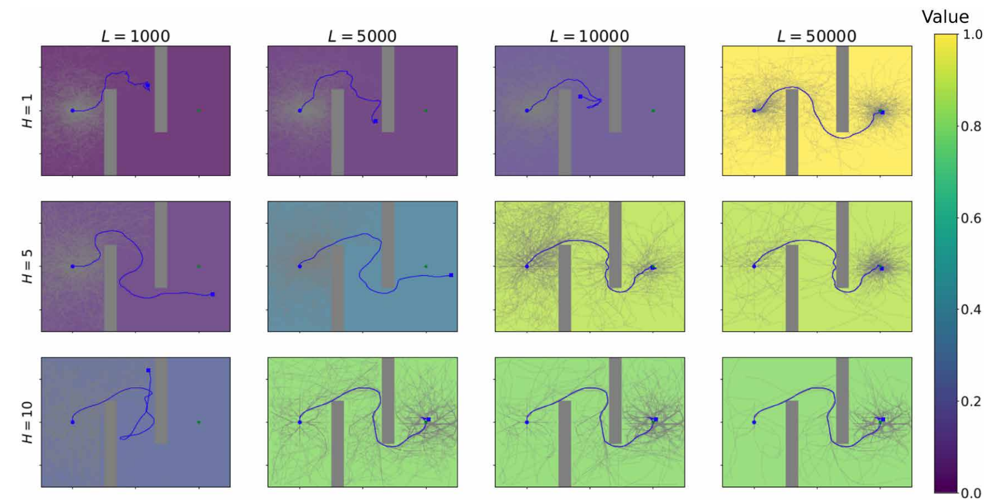
Evaluate
We assess SETS using a motion planning problem where a 2D double integrator begins at the blue dot on the left and aims to reach the green dot on the right. We experiment by adjusting the branch length parameter H and the total number of simulations L. The plots are shaded based on the trajectory values. The observed trend aligns with theoretical predictions: trees with large H converge quickly to suboptimal solutions, while trees with small H converge slowly but result in highly optimal solutions.

